Slide 1
Introduction to Data Science
Section 2 – Basic python and descriptive statistics

Slide 2
Basic python
Useful for loading, filtering, and displaying data:
pandas.read_csv()
display()
array['column name'].values
print()
type()
Red italics means you should fill it in with the correct variable names

Slide 3
Basic python
Useful for operating on numpy arrays:
len()
np.sum()
np.sqrt()
a**n, is a to the power of n
array**n, takes every element to the power of n

Slide 4
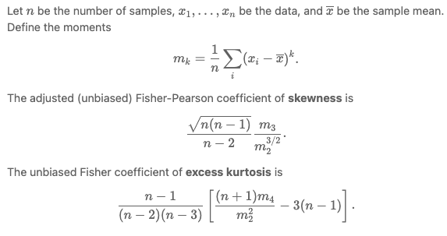
Sample skew and excess kurtosis

